Slide 1
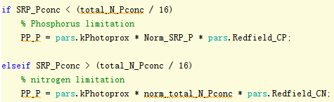
Big mistake....
This is the phosphorus primary production...

Slide 2

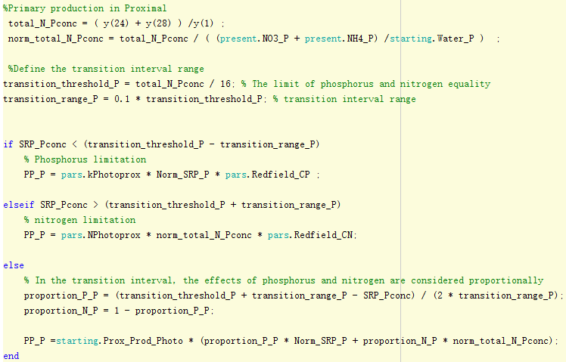
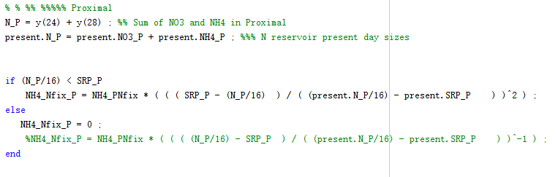
concentration |  | now uM
NO3 | P | 4
 | D | 15.3
 | S | 12
 | DP | 30
PO4- | P | 0.27
 | D | 1.4
 | S | 0.94
 | DP | 2.1
modern ocean is aerobic, nitrogen loss is fast, but there is no iron oxidation, so phosphorus precipitation is slow

Slide 3
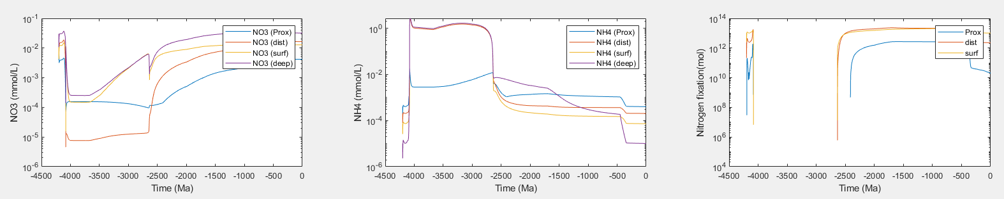
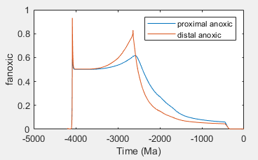
Why are they still high, especially in the surface and deep oceans？

Slide 4
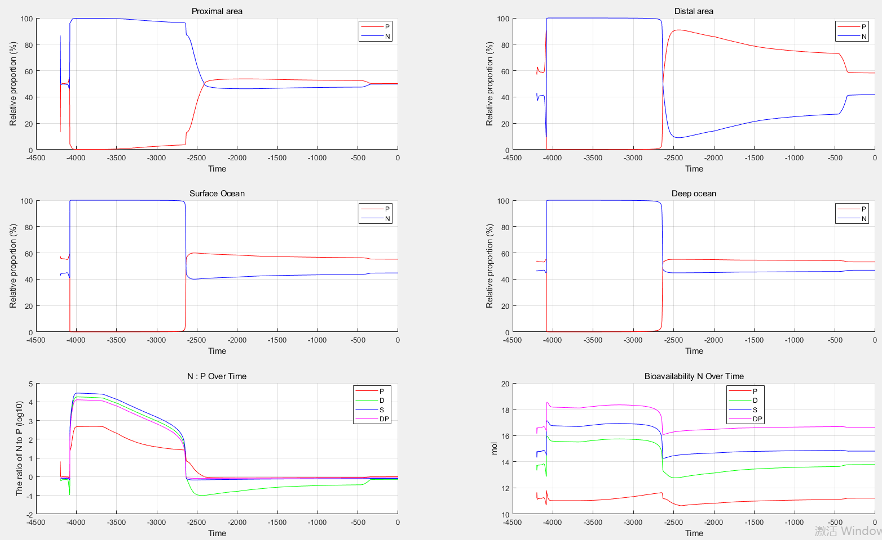

Slide 5
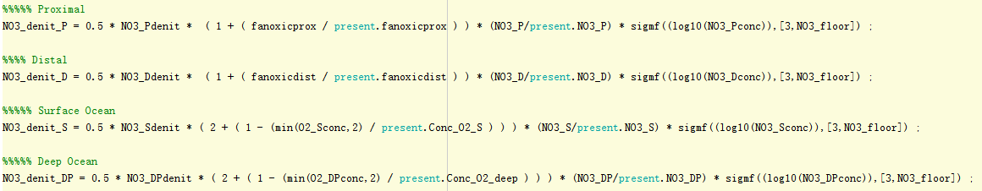
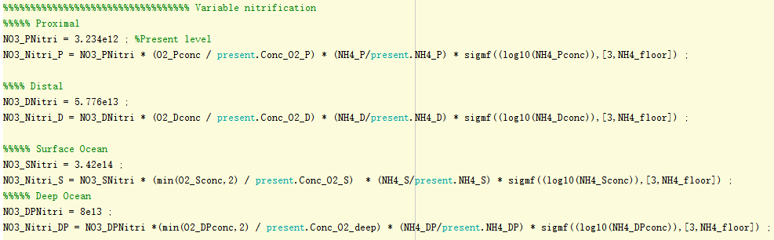
That could be the reason

Slide 6
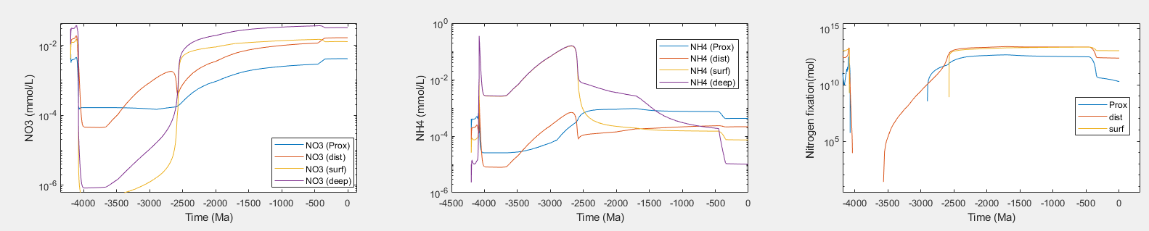
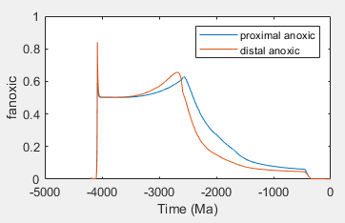
Nitrogen fixation leads to higher concentration of NO3 in distal area
Nitrogen restriction occurs, with lower primary production and less anoxic

Slide 7
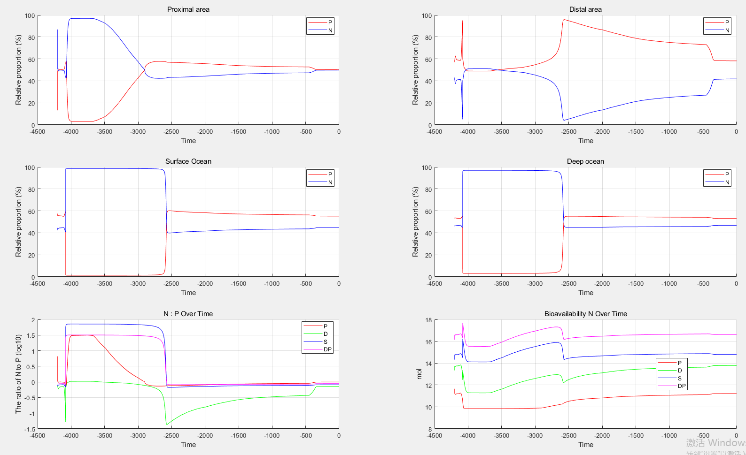

Slide 8
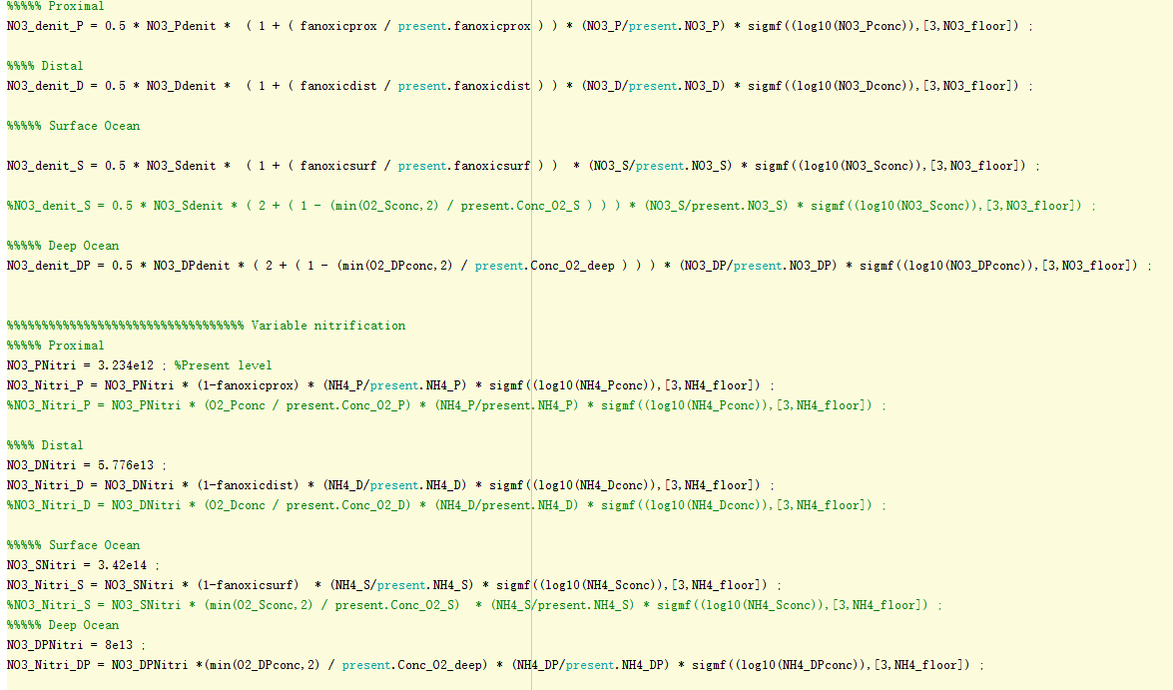

Slide 9
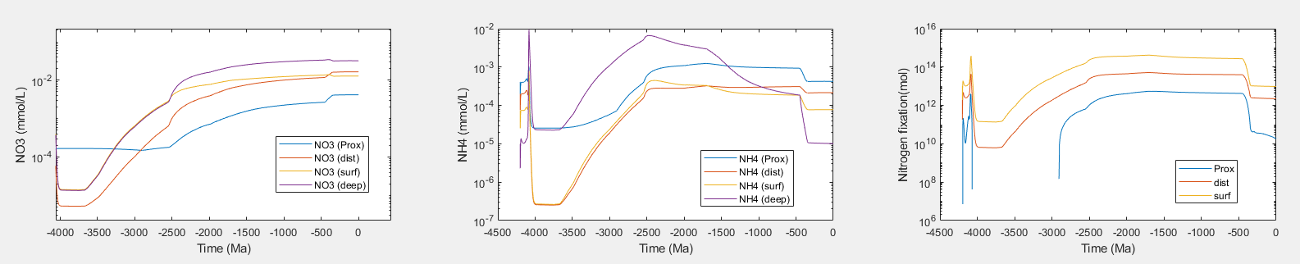
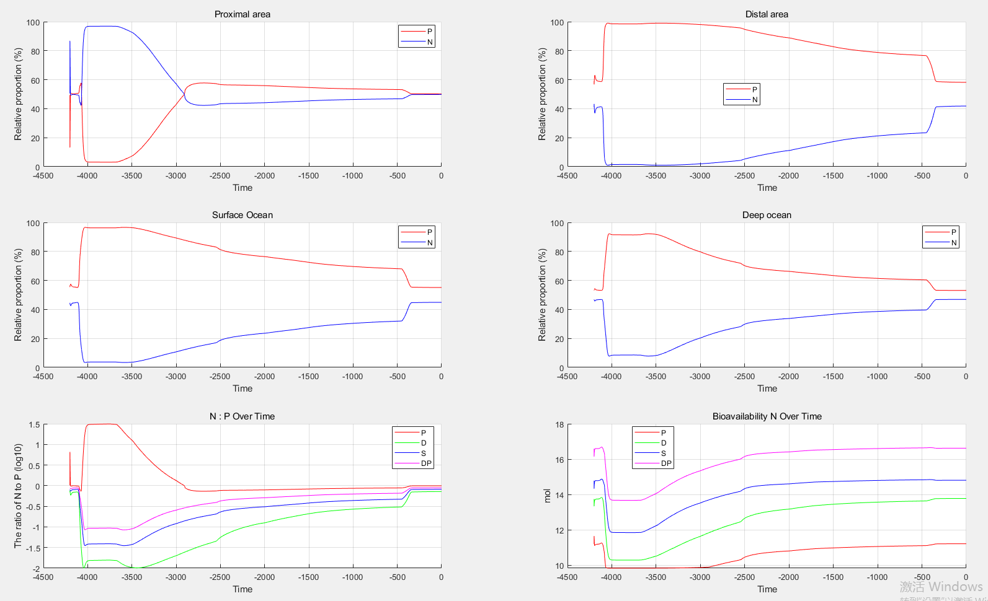

Slide 10
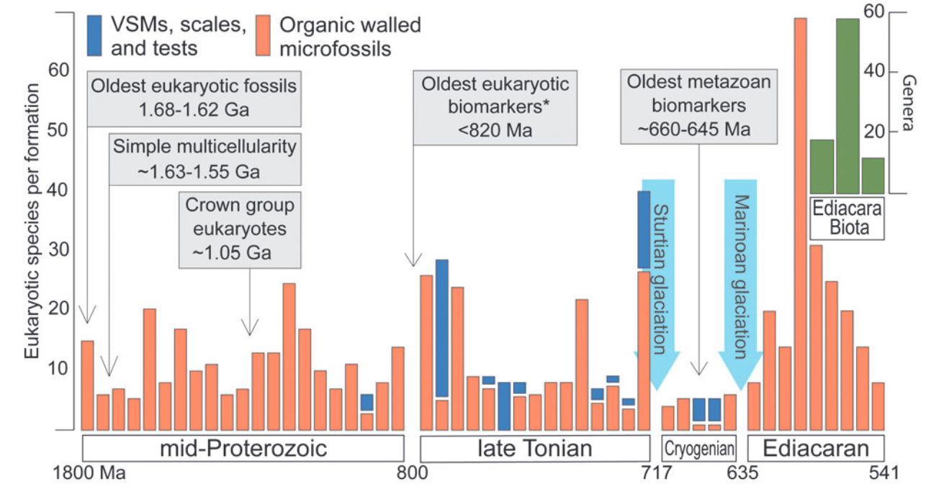
From the study of the geological record, it is found that the P limit or N limit in the proterozoic is very controversial.
The P limitation idea is that deep ocean water is ferruginous and so still removes most of the P from the water column.
The N limitation idea is that the first eukaryotic record appeared at 1.6Ga and did not flourish until after 0.8Ga (NOE). Many views suggest that this is due to NO3- limitation, since eukaryotes primarily assimilate NO3- rather than NH4+. In the same time, there are also many studies that show an increase in NO3- availability around 0.8Ga, however, our results do not find this, and the deep sea and surface NO3- are somewhat high in the Proterozoic period.

Slide 11
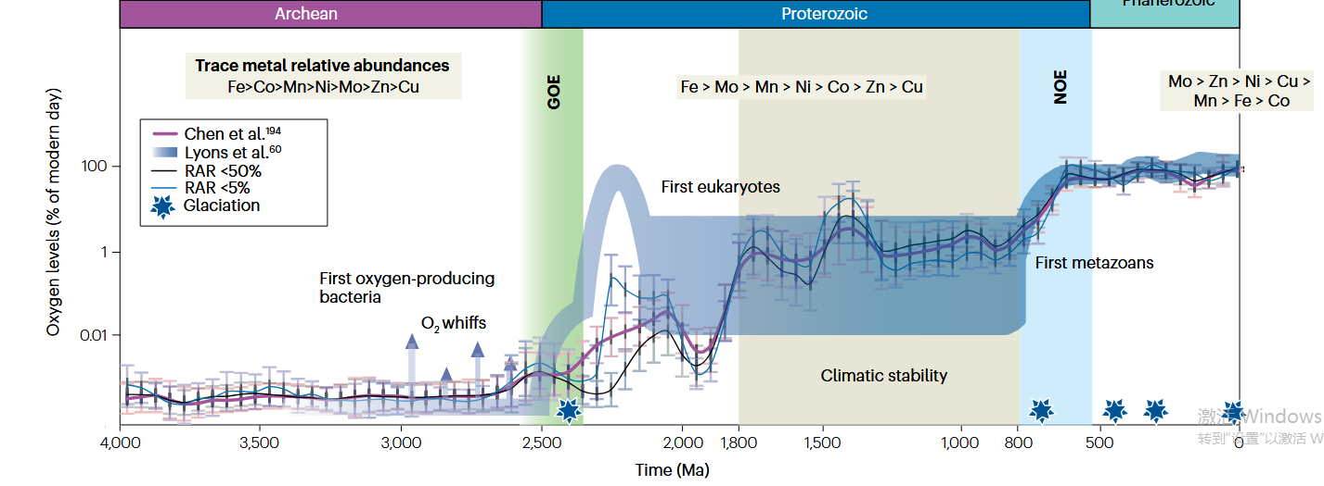
The model results do not seem to replicate this scenario, the triggering mechanism may be related to the formation of euxinia.

Slide 12
怎么用这个模型，首先看别人怎么用的，例如CP比（证明CP比很高时，才能触发GOE），以及别人加了铁循环发现了什么，还有其它应用？然后想不同的氮循环能怎么用，氮循环的复杂性，和铁磷的关系，最后是怎么跟热泉能结合。Sean 那个模型
看看有没有bif沉积速率的文章，有没有模型能涉及，再就是sean那篇文章的方法。全部结束后，思考自己的模型改动，问题，重新组织ppt

